Slide 1






@ChrastinaOndrej
@Simply007
@Simply007
Progressive Web Apps
ondrejchrastina
Notes:
Sources are on my github From 2015
Load UI quickly

Slide 2
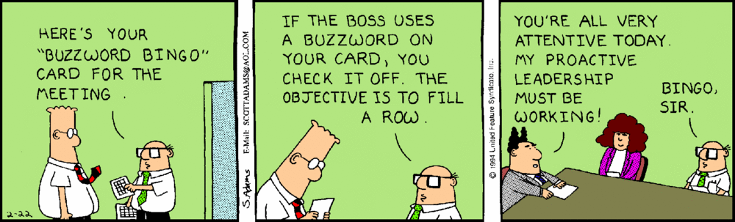

Progressive Web Apps
Reliable
Fast
Engaging
Progressive
Responsive
Connectivity independent
App-like
Fresh
Safe
Dicoverable
Re-engageble
Installable
Linkable
Notes:
First ??? Paint
* https://simply007.github.io/ReactiveConfPrague2018/Stay%20away%20from%20my%20path!/

Slide 3
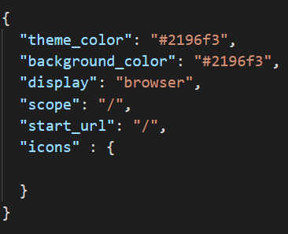
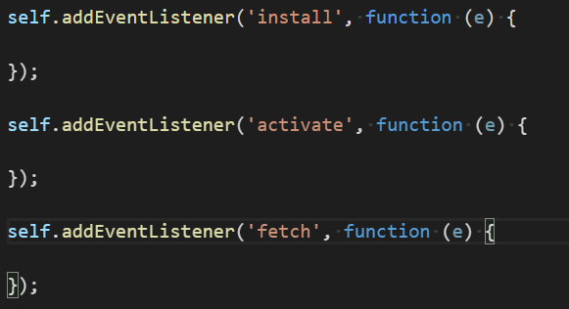
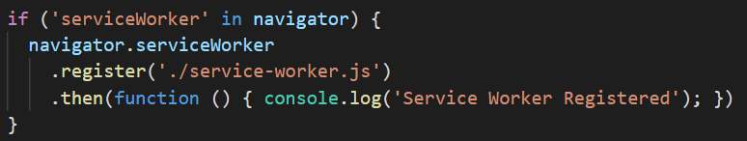
Progressive Web Apps
Web Manifest
Service worker + Cache API
Notes:
Manifest
Service worker
How does it work

Slide 4

Demo time
Notes:
Tutorial
https://codelabs.developers.google.com/codelabs/your-first-pwapp

Slide 5

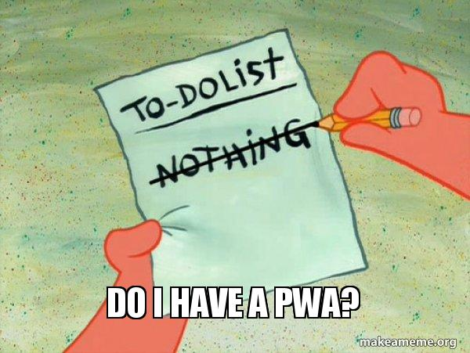

Lighthouse
Notes:
PWA Checklist
Lighthouse + https://webhint.io/ (sonarwhal)

Slide 6
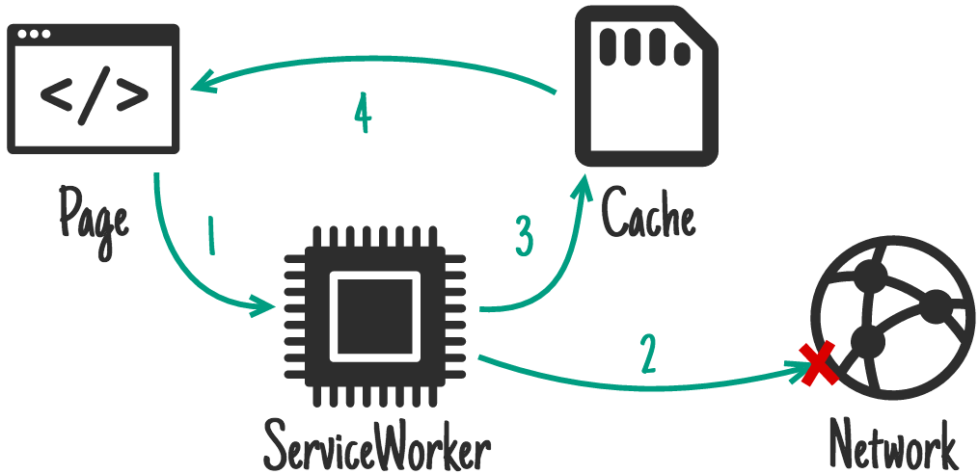
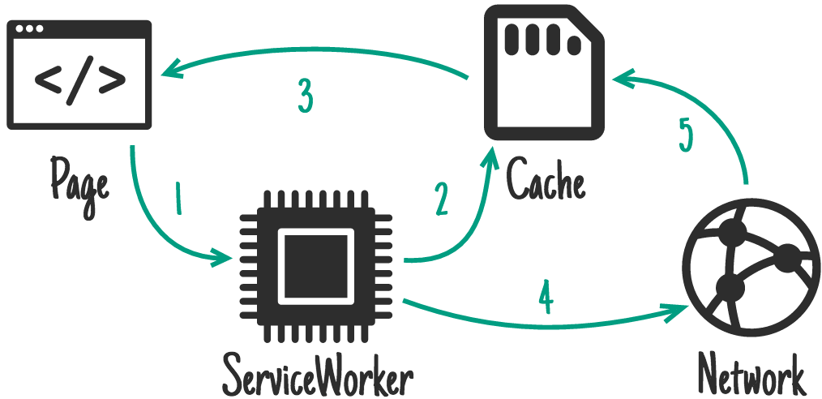

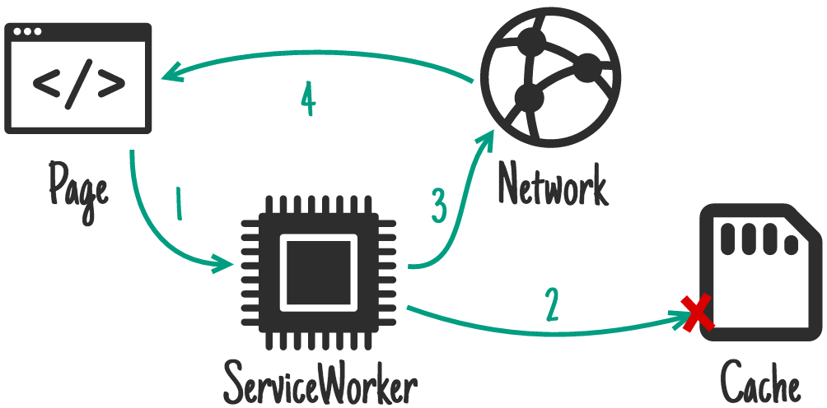
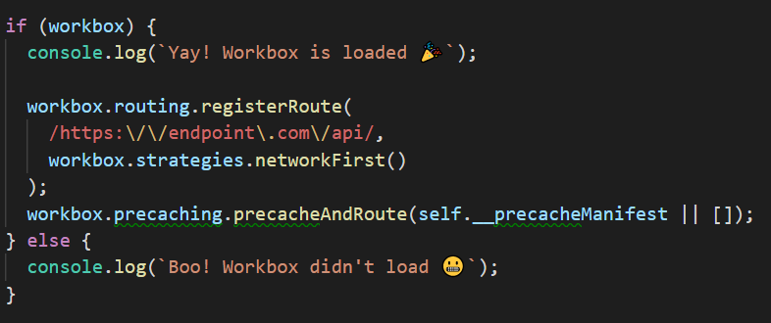
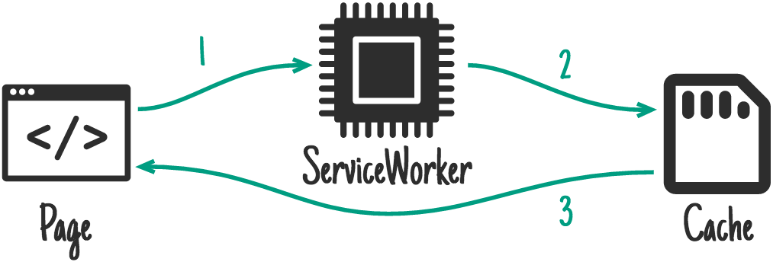
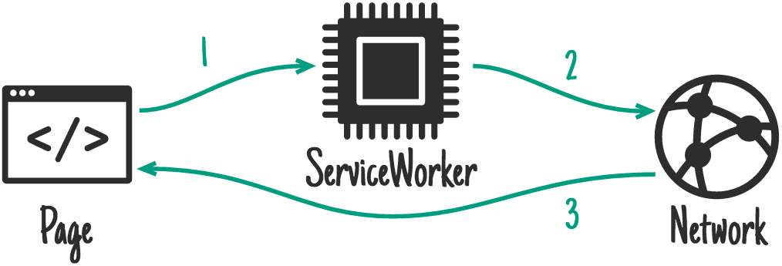



Notes:
Strategies

Slide 7



Google Progressive Web Apps
@bryan_soltis
w3.org
@ChrastinaOndrej
@Simply007
caniuse.com
@Simply007
ondrejchrastina
Notes:
Google wrap-up https://developers.google.com/web/progressive-web-apps/

